Slide 1


Giovanni Liberatore – Università di Firenze
VECTOR
A Vocational and Educational
Curriculum Design
from a Sector Skills Alliance
on TOuRism
Grant Agreement nr. 2015-3230

Slide 2












Partners
Italy
- Tuscany
Spain
- Castilla y Leon
Portugal
- LTV Region
- Algarve

Slide 3
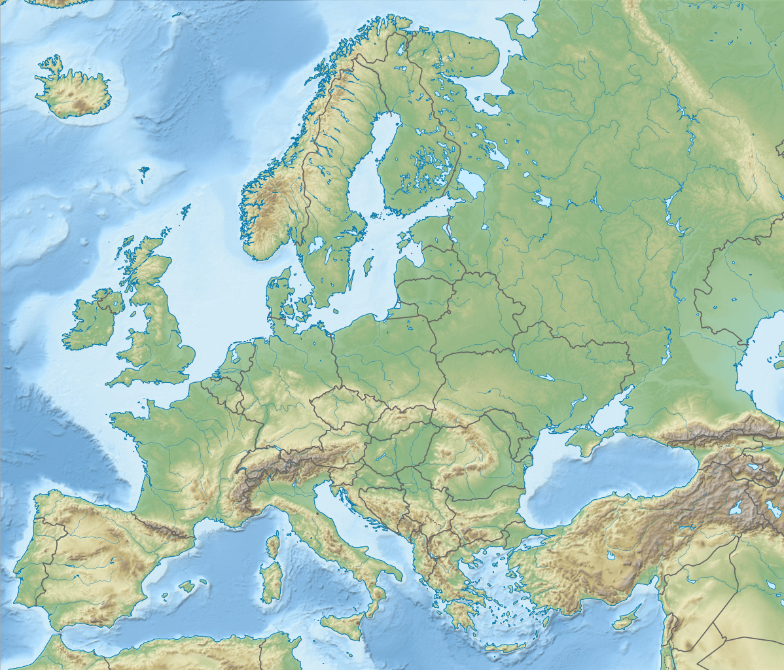
PARTNER
COUNTRIES
Italy
- Tuscany
Spain
- Castile and Leon
Portugal
- LTV Region
- Algarve
02/03 Dicembre 2015 – Firenze – Fondazione per la Ricerca e l’Innovazione

Slide 4
Focus of VECTOR
On the figure of the destination manager as:
a new and larger role, whose task is to integrate the main factors of local attractiveness and the tourist services, in a strategic perspective,
with the aim of giving the destination the right competitive positioning, in relation to the characteristics of the territory,
producing a growth of the networking and collaboration of tourism entities (SMEs, Research centers, public entities) in a triple helix perspective.

Slide 5
… objectives …
(a) define a joint professional profile of "destination manager", a profile that is capable of proposing strategies aiming at managing, enhancing and promoting tourist destinations in an integrated perspective;
(b) assure the creation of a curriculum able to address the planning and sustainable issues related with tourism promotion, ensuring both the increase of tourists flows and the safeguard of local communities;
(c) experiment and test innovative teaching methodologies to verify experiences and beliefs in VET courses in order to renovate policies and methodologies up with the times;
(d) endorse networking activities at EU level to exploit the project results and assure its sustainability after the project lifespan;
(e) design and delivering a joint vocational training programme/curriculum for the Destination Manager profile in Europe in the tourist sector.

Slide 6
A Vocational and Educational Curriculum Design from a Sector Skills Alliance on Tourism / VECTOR
… summary of activities …
1. SURVEY ON SKILL NEEDS AND SHORTAGE AT EUROPEAN LEVEL (state of the art, SWOT and cross-check analysis, etc) CONCERNING THE DM PROFILE
Explore the skills needs in tourism and exchange good practices, knowledge and experience among partners regarding the DM ability to manage, enhance and promote tourist destinations
2. DRAFT AN EQF BASED SET OF EDUCATIONAL STANDARDS FOR DESTINATION MANAGERS BASED ON PROJECT FINDINGS, ON CURRENT EUROPEAN VET DEVELOPMENTS, ON THE CHARACTERISTICS OF THIS OCCUPATION AND, CONSEQUENTLY, DEFINE A QUALIFICATION PROFILE FOR THIS OCCUPATION DESCRIBING KNOWLEDGE, SKILLS AND COMPETENCIES IN THE TOURIST FIELD ACHIEVING A 5th LEVEL IN THE RELATED EQF SYSTEM

Slide 7
3. DEVELOP AN INNOVATIVE AND JOINED TRAINING CURRICULUM RELATED TO THE DM PROFILE USING THE ECVET APPROACH AND EQAVET PRINCIPLES TO BE INCLUDED IN AN ONLINE COURSE (e-learning plattform)
4. ORGANIZE A PILOT PHASE IN SPAIN AND ITALY INVOLVING 24 TRAINEES TO TEST SOME OF THE MOST CRUCIAL AND INNOVATIVE MODULES INCLUDED IN THE DM TRAINING CURRICULUM.
Other units/modules of the e-learning plattform will be tested at distance with the support of tutors
5. VALIDATE THE DM PROFILE AND RELATED TRAINING CURRICULUM
A Vocational and Educational Curriculum Design from a Sector Skills Alliance on Tourism / VECTOR

Slide 8
… partecipazione ai wp…

Slide 10
A Vocational and Educational Curriculum Design from a Sector Skills Alliance on Tourism / VECTOR
… Target group …
(during the project lifetime)
DIRECT
INDIRECT
high school graduates having already experience in the sector;
people attending/wishing to attend higher education institutions or having interrupted their studies;
people having already a bachelor degree
higher education institutions,
VET providers,
local and regional promotional agencies,
SMEs providing services and technological products related to tourism,
local stakeholders and policy makers,
regional and national clusters,
participating institutions in the project

Slide 11
A Vocational and Educational Curriculum Design from a Sector Skills Alliance on Tourism / VECTOR
… Target group …
(after the project is finished)
DIRECT
INDIRECT
The beneficiaries of the new training curriculum
high school graduates having already experience in the sector;
people attending/wishing to attend higher education institutions or having interrupted their studies;
people having already a bachelor degree;
touristic destinations
touristic destinations population
unemployed
higher education institutions,
VET providers,
local stakeholders and policy makers,
regional and national clusters,
participating institutions in the project
associated partners
having the opportunity of counting on a DM profile in their staff
companies providing services, technological products and any kind of actions related to tourism industry/supply chain;
tourism promotional agencies

